Slide 1
Sprint 1
Alzheimer's Facial Recognition
Gabriel Thomas, Irald kollcinaku, Robert Turczyn, Tyler Schauss, Jacob Carpenter, Zilin Li

Slide 2
Vision Statement
Our vision is to build a bridge between humans and machines through software technology. Through a skilled team of developers, we acknowledge the need for a change in medical conditions that affect not only the patients but also their loved ones. Our team strives to build a superior app to empower Alzheimer's patients recognize people in their daily routine.
Incorporating facial recognition, tracking and reminders is our main focus in constructing this helpful app.

Slide 3
Project Objectives
Setup an AWS hosted server
Will host MySQL Database
Will hold data for client’s contacts
Will hold images of client’s contacts
Use the device camera to achieve facial recognition
Utilize text to speech to upon facial recognition
Will tell client the recognized contact’s information
Allow clients to upload images and data of contacts
Allow caretakers to upload images and informations that is connected to a client’s account
Use PWA to create a web portal as well as Android and iOS apps
Possible implement a location setting that can show the location of a client to a caretaker.

Slide 4














Devops Toolchain
Tools
Platforms Libraries
Languages

Slide 5
Functional Requirements
REQ1- The system shall use the device camera to run Open CV code
REQ2- The system shall recognize faces seen by the device camera
REQ3- The system shall use TTS (text-to-speech) via device audio output to say the name of the person recognized
REQ4- The system shall have a web portal
REQ5- The system shall have an app version that runs on Android and iOS
REQ6- The system shall have a caretaker portal that can connect to a clients account
REQ7- The system shall have a way for the client to add many pictures to a Database for Open CV to recognize faces.

Slide 6
Functional Requirements Cont...
REQ8- The caretaker portal shall have an option to enter pictures for the client’s app to recognize faces
REQ9- The system shall have a feature that turns the device’s screen black while in the clients pocket to preserve battery life.
REQ10- The system shall alert the client upon facial recognition
REQ11- The system should have a location setting that can be turned on and off to allow a caretaker to see where the client is

Slide 7
Non-Functional Requirements
NFR1- The system shall have a MySQL Database to store images
NFR2- The system shall have a MySQL Database to store text information, such as, name, relation, etc…
NFR3- The system shall be able to send a facial recognition message with TTS data in less than a minute
NFR4- The system shall have a backend server setup to host necessary applications

Slide 8
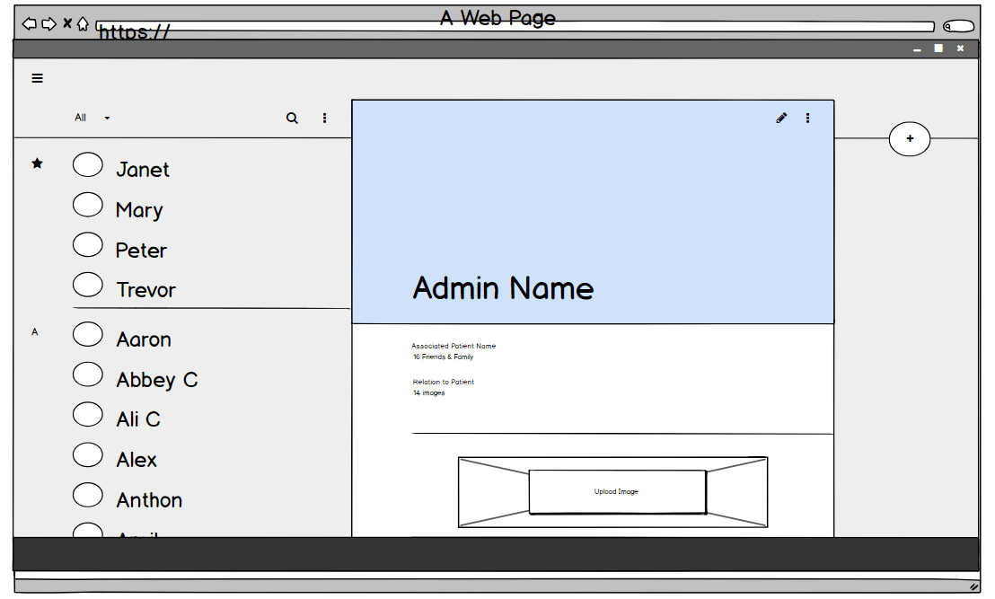
Views

Slide 9
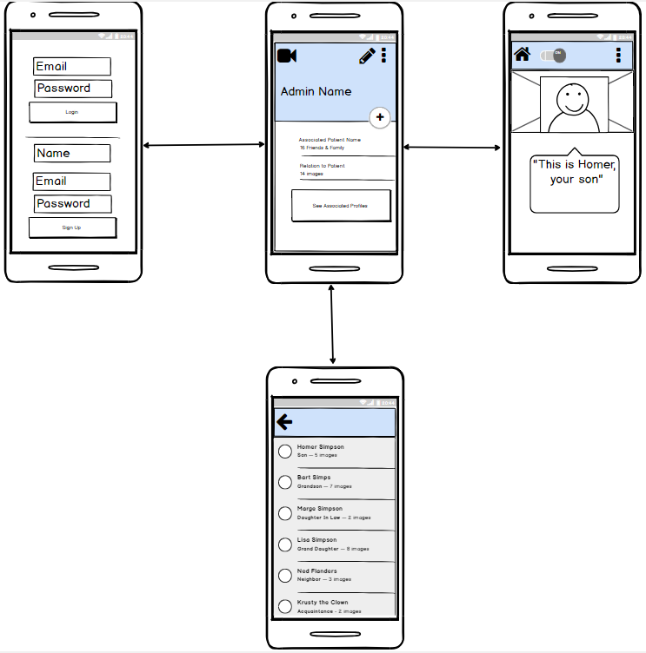
Views

Slide 10
Possible Risks
Time
Most of us unfamiliar with PWA apps
None of us have used this tech stack before
Performance
Battery Life of Phone
How long it takes to recognize a face
How lighting conditions will affect recognition

Slide 11
Mitigation Plan
Schedule one in-person meeting and at least one online meeting a week to track project to solve issues and ensure we finish related works within every phase.
We may use another facial detection and recognition android sdk provided by Arcsoft if we cannot implement OpenCV.
Keep screen dimming until client start to use this application.
We will constantly update the risk mitigation plan in the following development life cycle.
Notes:
Zilin Li

Slide 12
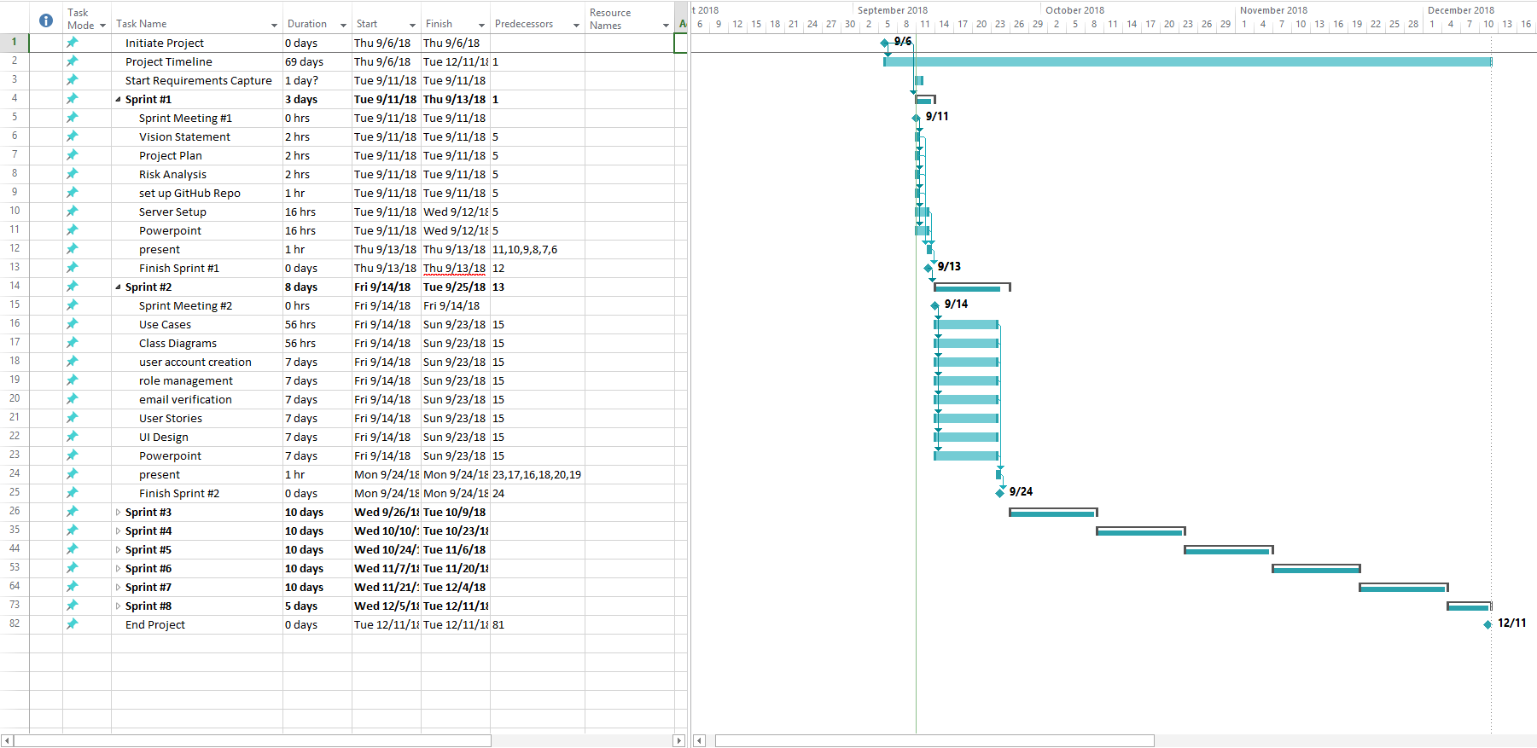
Project Plan

